Slide 1

How to make DSL more federated
Zhuoyu Yao, Yue Wang
Computer Science
Georgia State University, Atlanta, GA, USA
Oct 22, 2024
Ack： NSF #2231209 CCSS: Distributed Swarm Learning for Internet of Things at the Edge

Slide 2
Outline
Introduction
Existing research
Proposed design and method
Preliminary results
Summary and future work

Slide 3

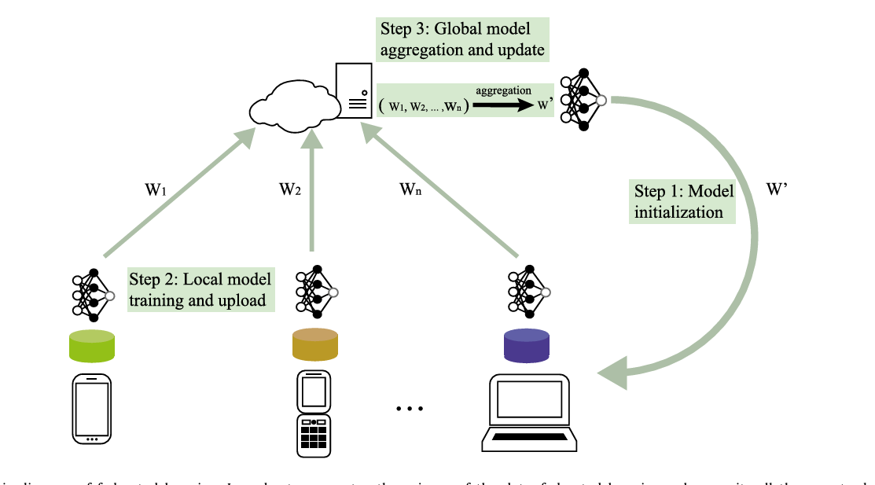

Introduction – Federated Learning
To propose solutions with scattered datasets
Stand-alone methods
Low performance
Centralized methods
Data leak
Distributed methods: FL^{[1]}
Upload parameters
Data Privacy
Low transmission cost
[1] Zhang C, Xie Y, Bai H, et al. A survey on federated learning[J]. Knowledge-Based Systems, 2021, 216: 106775.

Slide 4
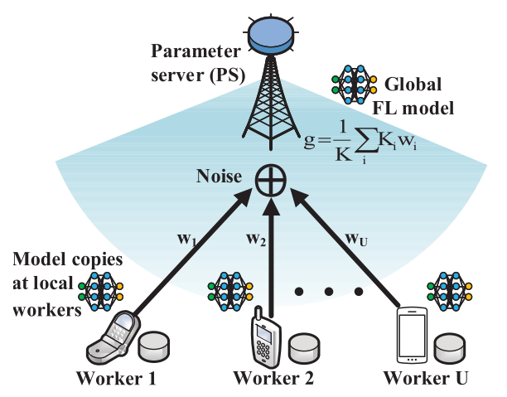

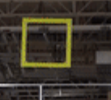




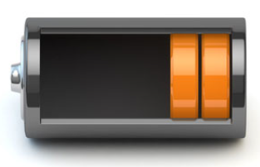
Introduction – Federated Learning
Challenges in FL
✗
Communication bottleneck
✗
Data/device heterogeneity
✗
Non-convex optimization
✗
Security concerns
gradient descent

Slide 5
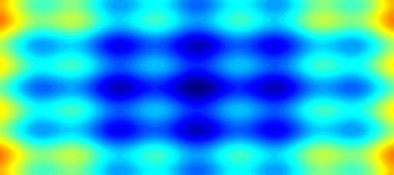

Introduction Swarm Biological Intelligence
Biological intelligence of swarm organisms
c₁
c₂
w_{i,t+1}
c₀
w_{i,t}
Starling murmuration by Marco Valk
Schooling fish by bioGraphic
w_{i,t-1}
Kennedy’95
Particle swarm optimization (PSO)
zero-th order stochastic
Inertia
Towards personal best
Towards group best
Pros of PSO
Cooperation training
Escape from local traps
No-ii..d tolerance
Limits in distributed learning
Slow convergence
✗
Common loss function among workers
✗

Slide 6
Outline
Introduction
Existing research
Proposed design and method
Preliminary results
Summary and future work

Slide 7
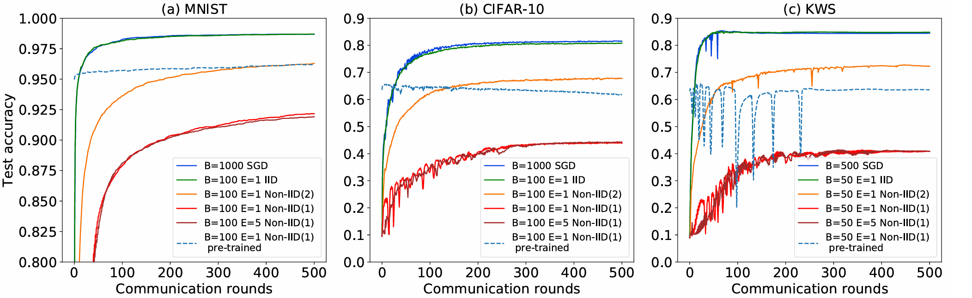
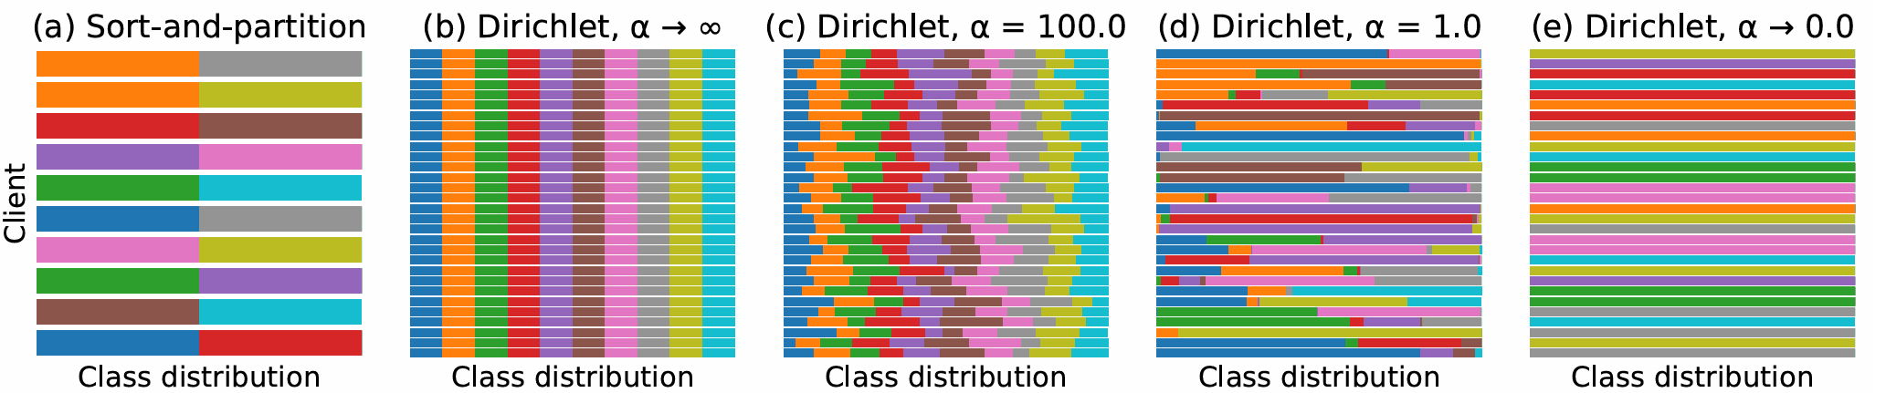
Existing research – Non-i.i.d Data Issue
Not identically and independently distributed data
Data diversity: Feature, Label, Quantity
Performance degradation
Definition:
Generation: Dirichlet Distribution^{[1]}
Controllable Split
Evaluation: Kolmogorov–Smirnov test ^{[2]}
Step I: Calculate the KS statistics
Step II: Hypothesis is approved if
Step III: Count the ratio of non-iid datasets pairs and all pairs.
[1] Hsu T M H, Qi H, Brown M. Measuring the effects of non-identical data distribution for federated visual classification[J]. arXiv preprint arXiv:1909.06335, 2019.
【2】Fasano G, Franceschini A. A multidimensional version of the Kolmogorov–Smirnov test[J]. Monthly Notices of the Royal Astronomical Society, 1987, 225(1): 155-170.
Notes:
As the local datasets may be highly different, the differences contains the diversity in feature, label and data quantity
Weight divergence
How to generate no-iid data subset in iid dataset? Obviously we can artificially split local data by label, but there is more reliable way: Dirichlet Distribution
KS test is a classical non-parametric hypothesis test, used to identify if the distribution of two samples are similar
Empirical distribution function

Slide 8
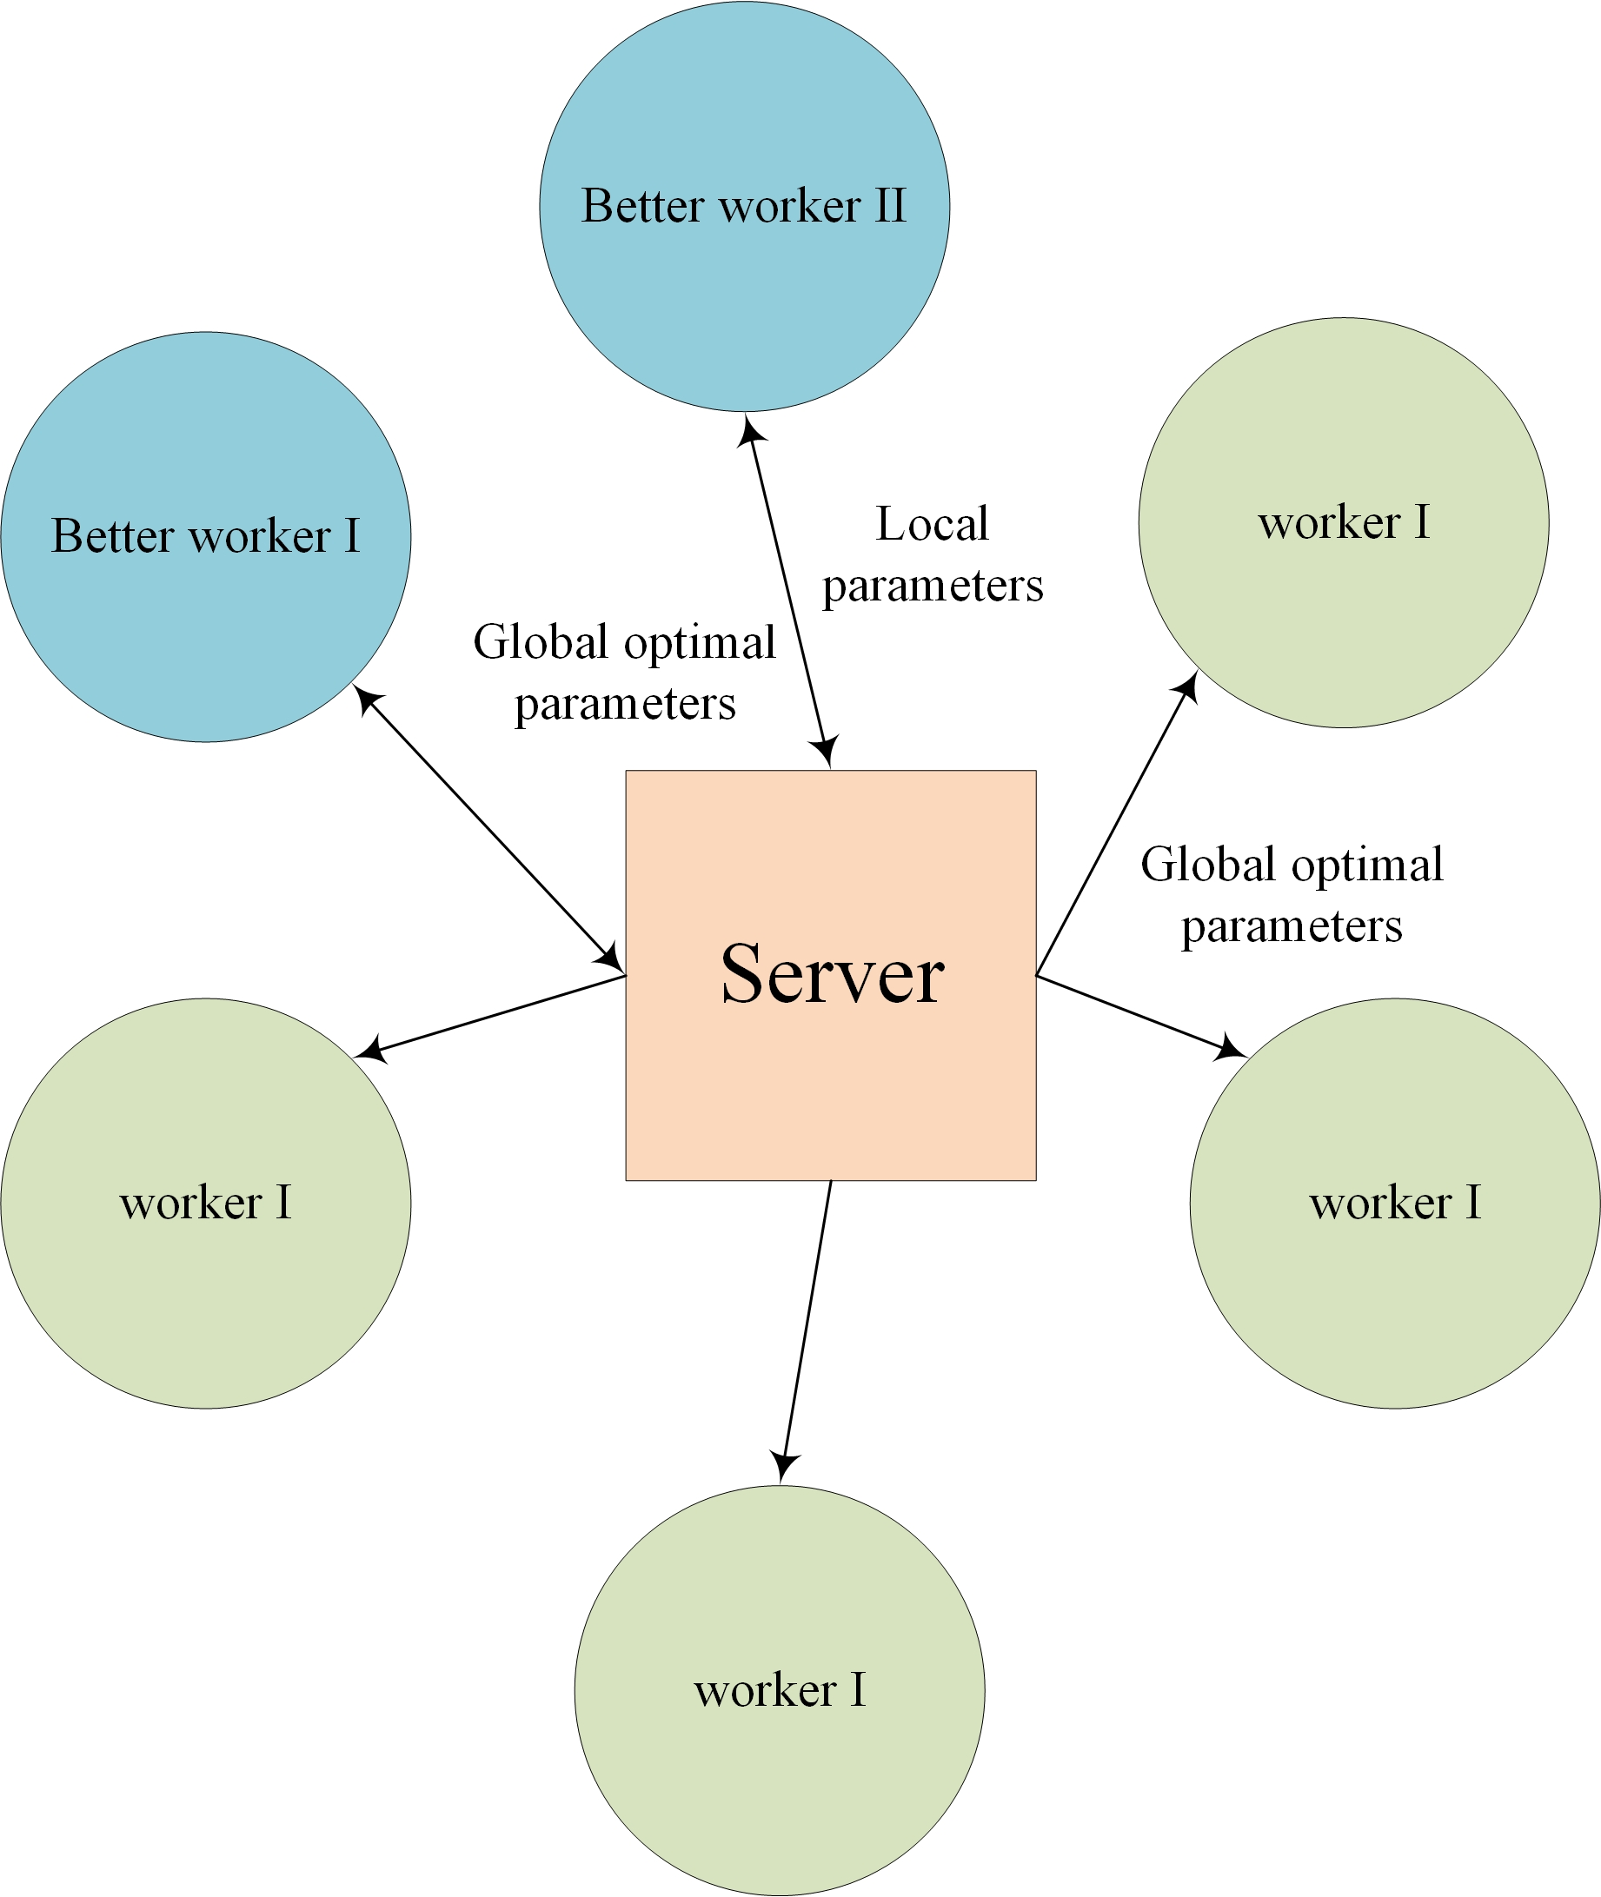
Existing research – DSL Framework
Distributed Swarm Learning^{[1]}: SGD + PSO
Some “strong” local workers should play a more important role.
 | PSO | DSL | FL
Commun. | low (U func. values + 1 model) | low (U func. values + S model) | High (U models)
Computation | zero-th order | first order | first order
Convergence | slow | fast | fast
Trap escape | capable | capable | unable
Model structure
[1]Wang Y, Tian Z, Fan X, Cai Z., et al. Distributed swarm learning for edge internet of things[M]. IEEE Communications Magazine, 2024.

Slide 9
Existing research – DSL Formulation
Key Idea: Parameters Update function^{[1]}
CB-DSL: Communication-Efficient and Byzantine-Robust Distributed Swarm Learning
Generate global scoring data
[1]Wang Y, Tian Z, Fan X, Cai Z., et al. Distributed swarm learning for edge internet of things[M]. IEEE Communications Magazine, 2024.

Slide 10
Existing research – DSP Implementation
Worker i
Receive: ; otherwise
Update:
Score:
Maintain:
Report:
Upload: (if invited ) ; otherwise keep silent
Parameter Server
Compare: and select:
If , then invite ; otherwise no worker invited
If , kick out attackers and keep selection
Broadcast
PS
report
upload
Broadcast
enable to screen attackers

Slide 11
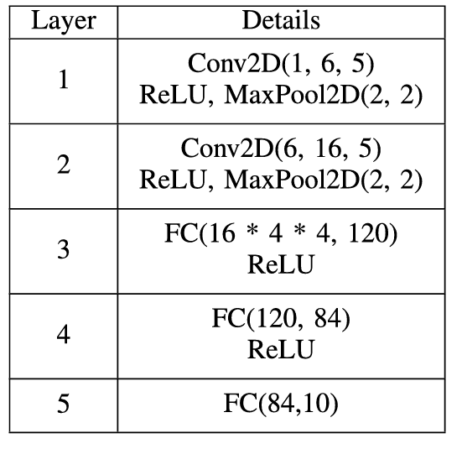
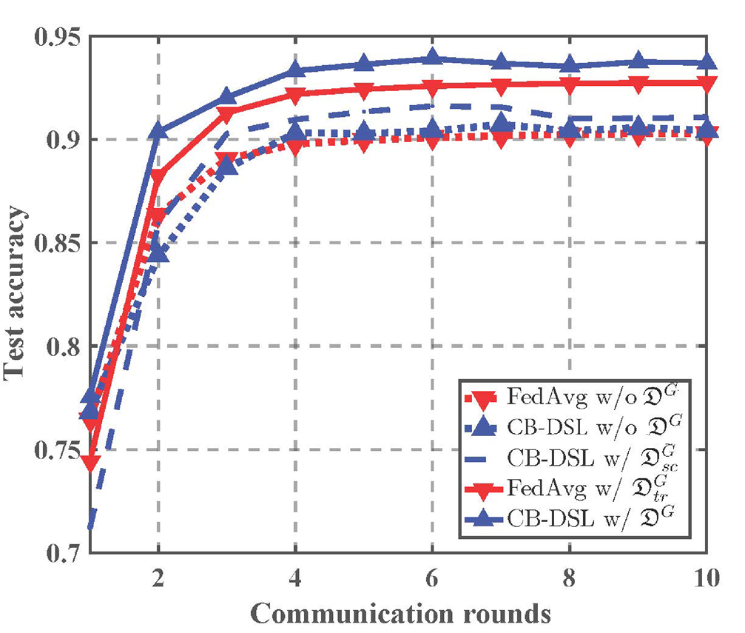
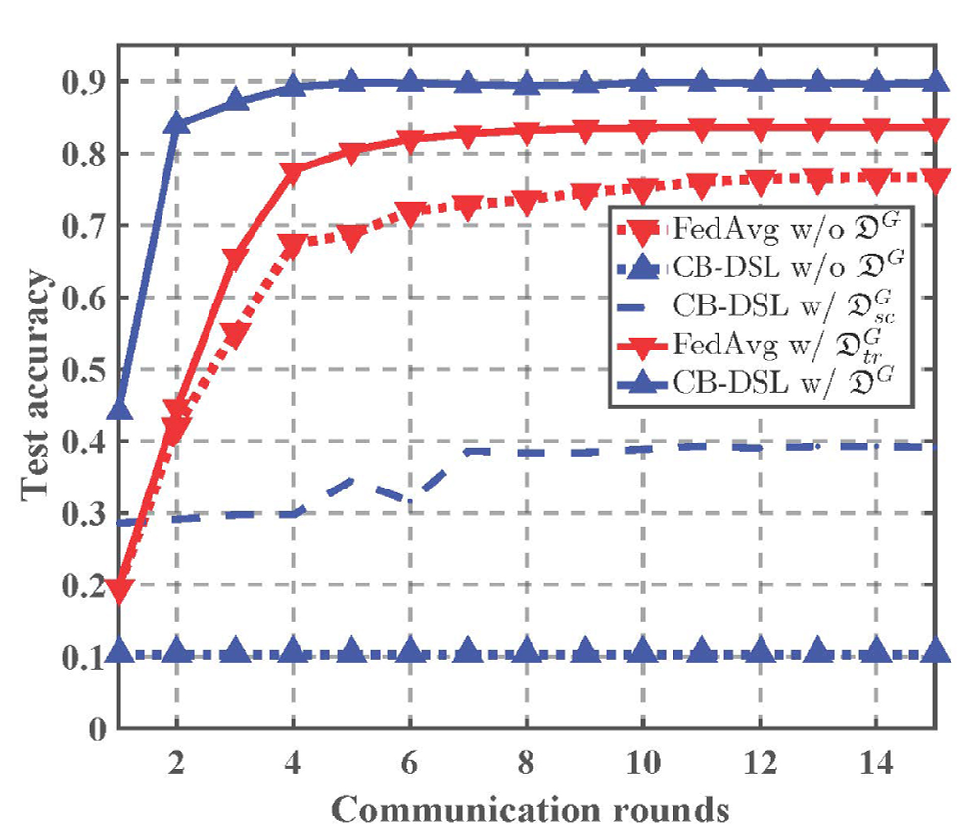
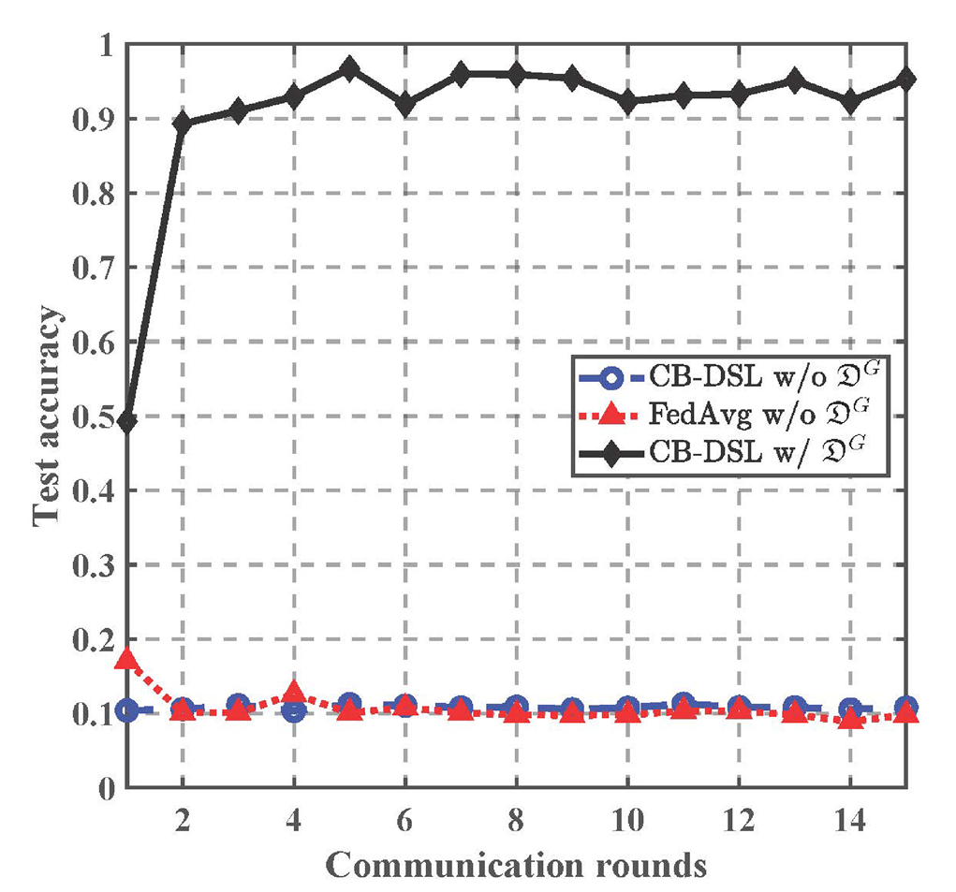
Existing research – Simulation Results
MNIST Classification:
Trained model: CNN
Datasets:
50 local workers, 300 samples;1server, 2000 samples
No-i.i.d datasets: 492 no-iid pairs in1275 pairs
i.i.d data
492/1275 No-i.i.d data
Byzantine attacker under i.i.d data
Notes:
Hsu T M H, Qi H, Brown M. Measuring the effects of non-identical data distribution for federated visual classification[J]. arXiv preprint arXiv:1909.06335, 2019.

Slide 12
Outline
Introduction
Existing research
Proposed design and method
Preliminary results
Summary and future work

Slide 13
Challenges and Motivation
Problems in existing DSL methods
Not federated enough: just best worker selection
Flaw of PSO: hard to escape from local optimal solution
Q: How to train the global optimal model with several better worker efficiently?
Solutions: Entropy Maximum Distributed Swarm Learning (EM-DSL)
How to select better workers
How to contribute by better workers
How to transmit / aggregate among better workers
Exploration score &
Entropy maximization
Adaptively weight on exploration and exploitation
Over-the-air Aggregation

Slide 14
Proposed Method: Exploration Score in DSL
Multi-worker selections: to enhance exploration capability
Parameter updating function
Individual exploration score ^{[1],[2]}: the improvement & diversity of the i-th worker.
Selection:
The top k.
The worker better than the average of selected workers in last round.
[1] Wu H, Qu Y, Lin S, et al. Contrastive learning for compact single image dehazing[C]//Proceedings of the IEEE/CVF conference on computer vision and pattern recognition. 2021: 10551-10560.
[2] Amin S, Gomrokchi M, Satija H, et al. A survey of exploration methods in reinforcement learning[J]. arXiv preprint arXiv:2109.00157, 2021.
Notes:
Evaluation of exploration: the convergence ratio, available searching space, diversity, flexibility

Slide 15
Proposed Method: Exploration Enhanced by EM
Avoid local optimal solution: Adding “controlled” Random ^{[1],[2]}
Initial parameters:
Optimal parameters:
Enhance exploration: maximum params entropy
Kraskov-Stögbauer-Grassberger (KSG) estimator ^{[2]}
[1] Mahankali S, Hong Z W, Sekhari A, et al. Random Latent Exploration for Deep Reinforcement Learning[J]. arXiv preprint arXiv:2407.13755, 2024.
[2] Kim D, Shin J, Abbeel P, et al. Accelerating reinforcement learning with value-conditional state entropy exploration[J]. Advances in Neural Information Processing Systems, 2024, 36.
Notes:
Multi-worker selections: Advanced capacities on exploration

Slide 16
Proposed Method: Entropy maximization
Maximum Entropy: KSG estimator
Entropy:
non-parametric entropy estimators: KL estimator ^{[1]}
mutual information estimators: KSG estimator ^{[2]}
Joint distance:
Joint entropy:
Individual entropy:
Conditional entropy:
[1] Kim D, Shin J, Abbeel P, et al. Accelerating reinforcement learning with value-conditional state entropy exploration[J]. Advances in Neural Information Processing Systems, 2024, 36
[2 ]Kraskov A, Stögbauer H, Grassberger P. Estimating mutual information[J]. Physical Review E—Statistical, Nonlinear, and Soft Matter Physics, 2004, 69(6): 066138.
.
Notes:
Compute the condition entropy by H(x,y) and H(X).
k-nearest neighbor estimator
But if the length scale of X and Y is very different, the estimation of H(x,y) will be unreliable.

Slide 17
Proposed Method: EM+DSL
Maximum Entropy: KSG estimator
Bounded entropy:
Notes:
Compute the condition entropy by H(x,y) and H(X).
k-nearest neighbor estimator
But if the length scale of X and Y is very different, the estimation of H(x,y) will be unreliable.

Slide 18

Proposed Method: Worker contribution in EM-DSL
Diverse the exploration capacity in each worker
higher $ρ$-> Better local datasets & better computational capacity
Adaptively select better worker in each round
Notes:
Multi-worker selections: Advanced capacities on exploration

Slide 19
Outline
Introduction
Existing research
Proposed design and method
Preliminary results
Summary and future work

Slide 20
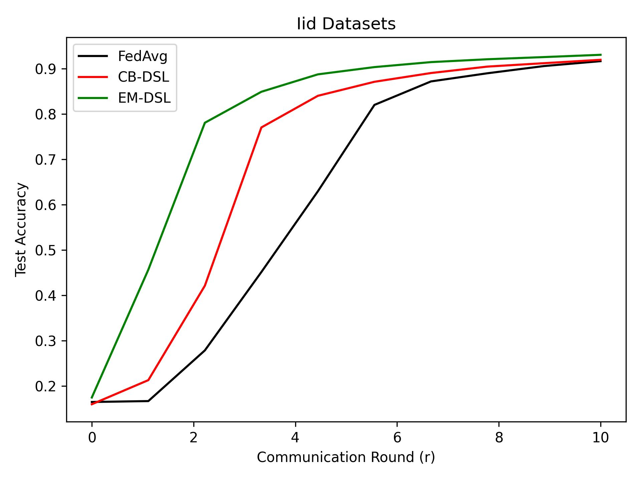
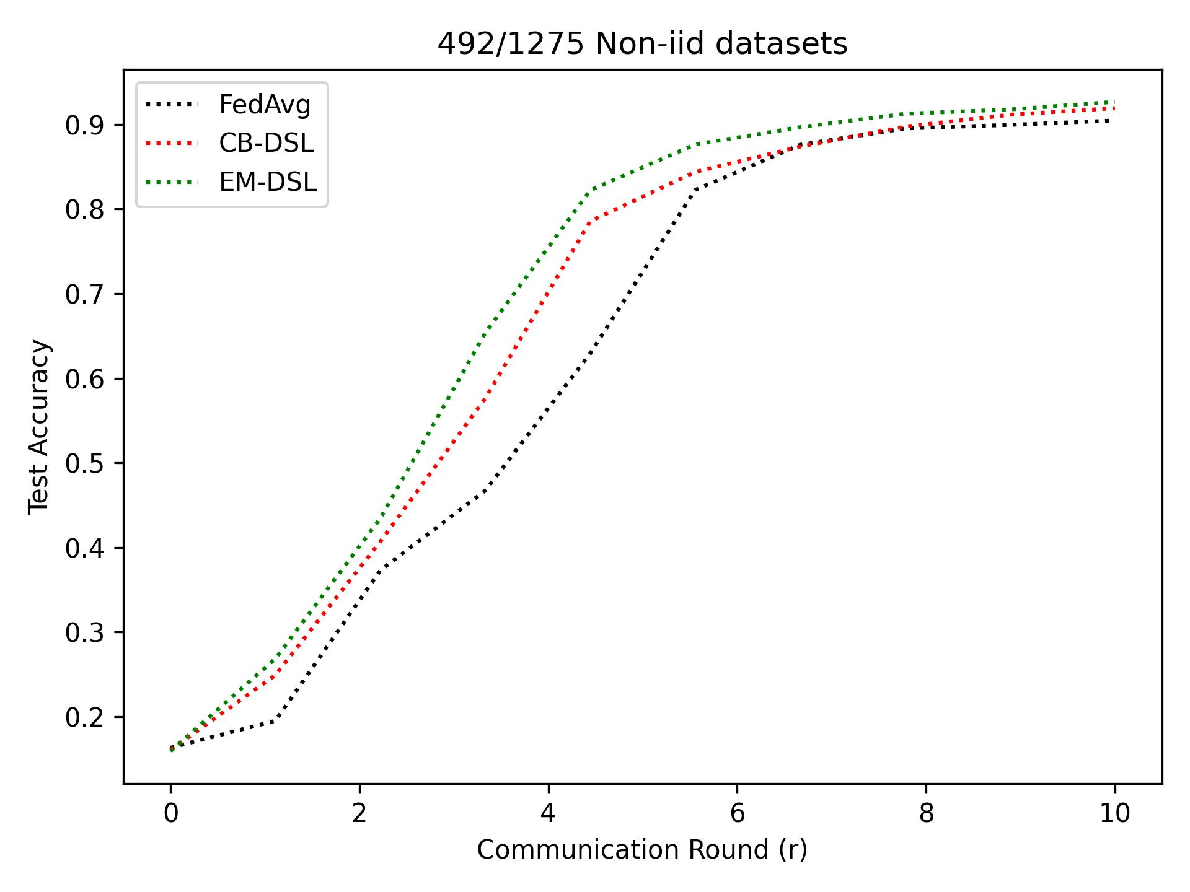
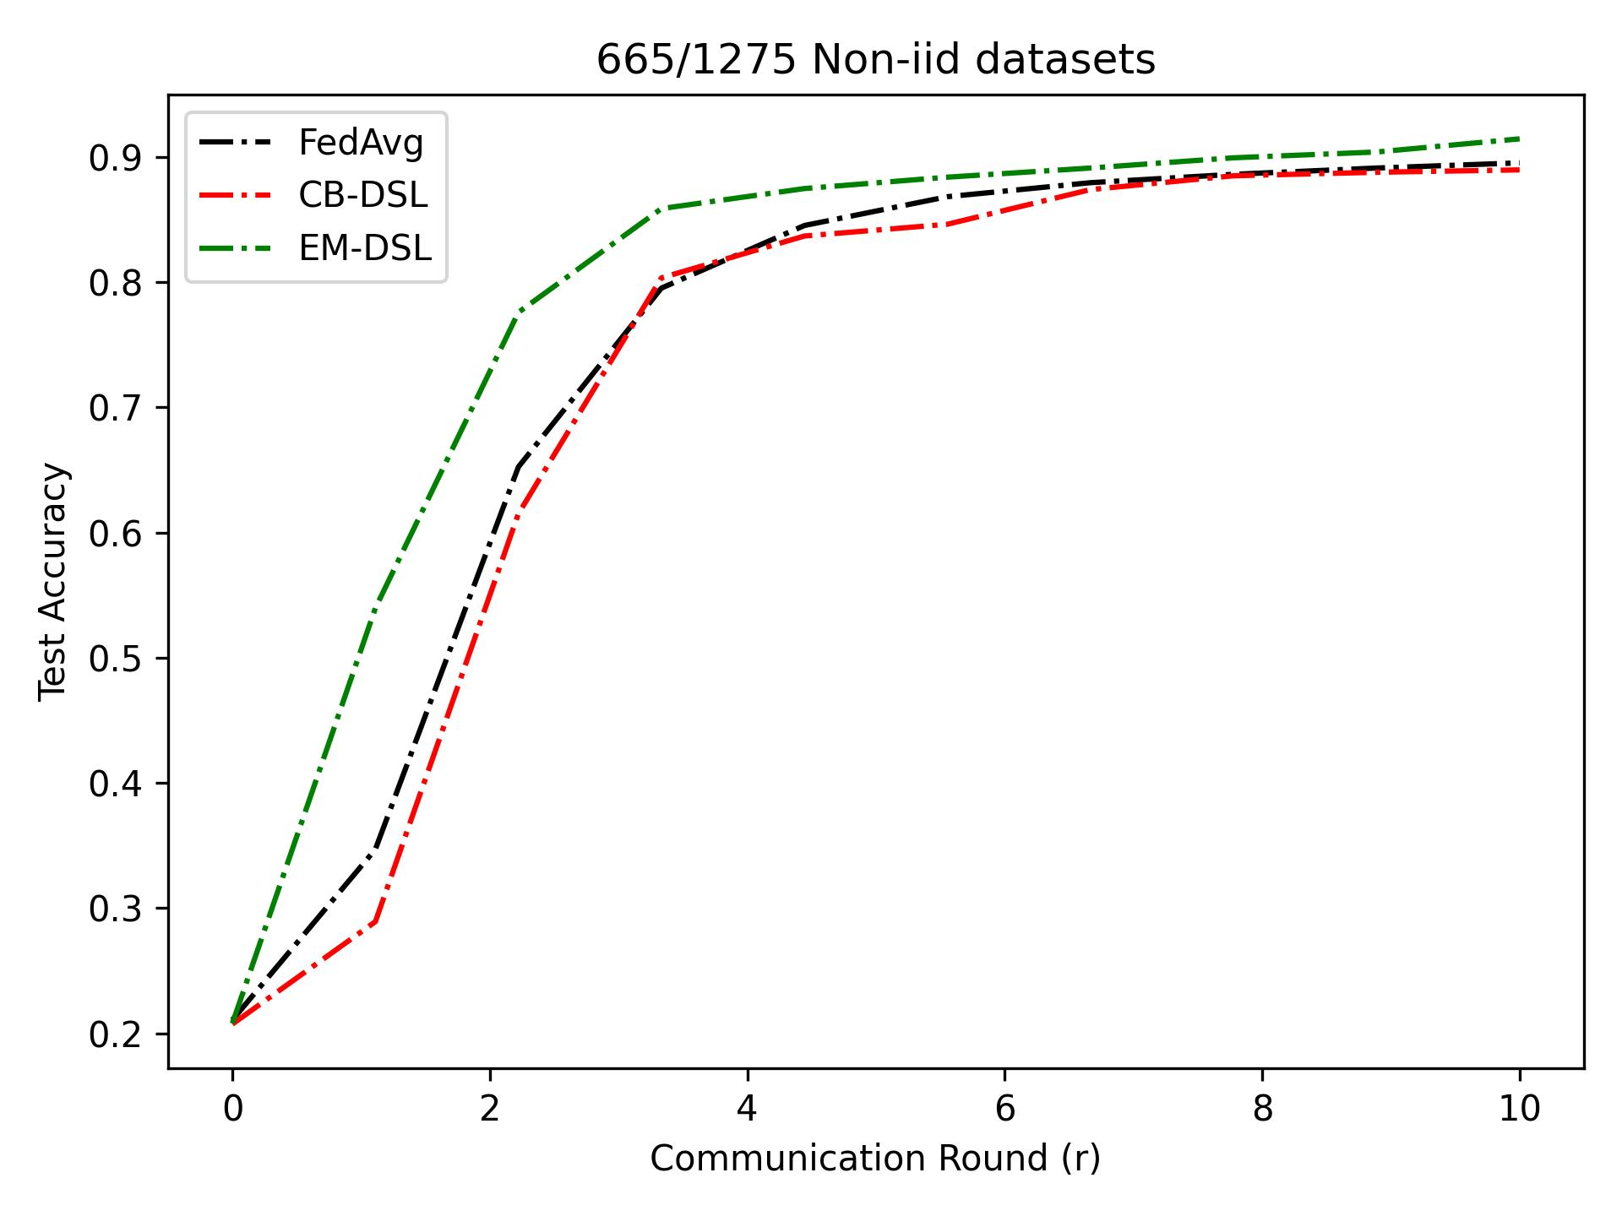
Simulation Result
MNIST Classification:
Datasets: 50 local workers, 300 samples in each; A server, 2000 sample.
No-i.i.d data rate: KS test, the similarity of pairs
Results with seed 2355589748
Higher accuracy & Quicker convergence

Slide 21
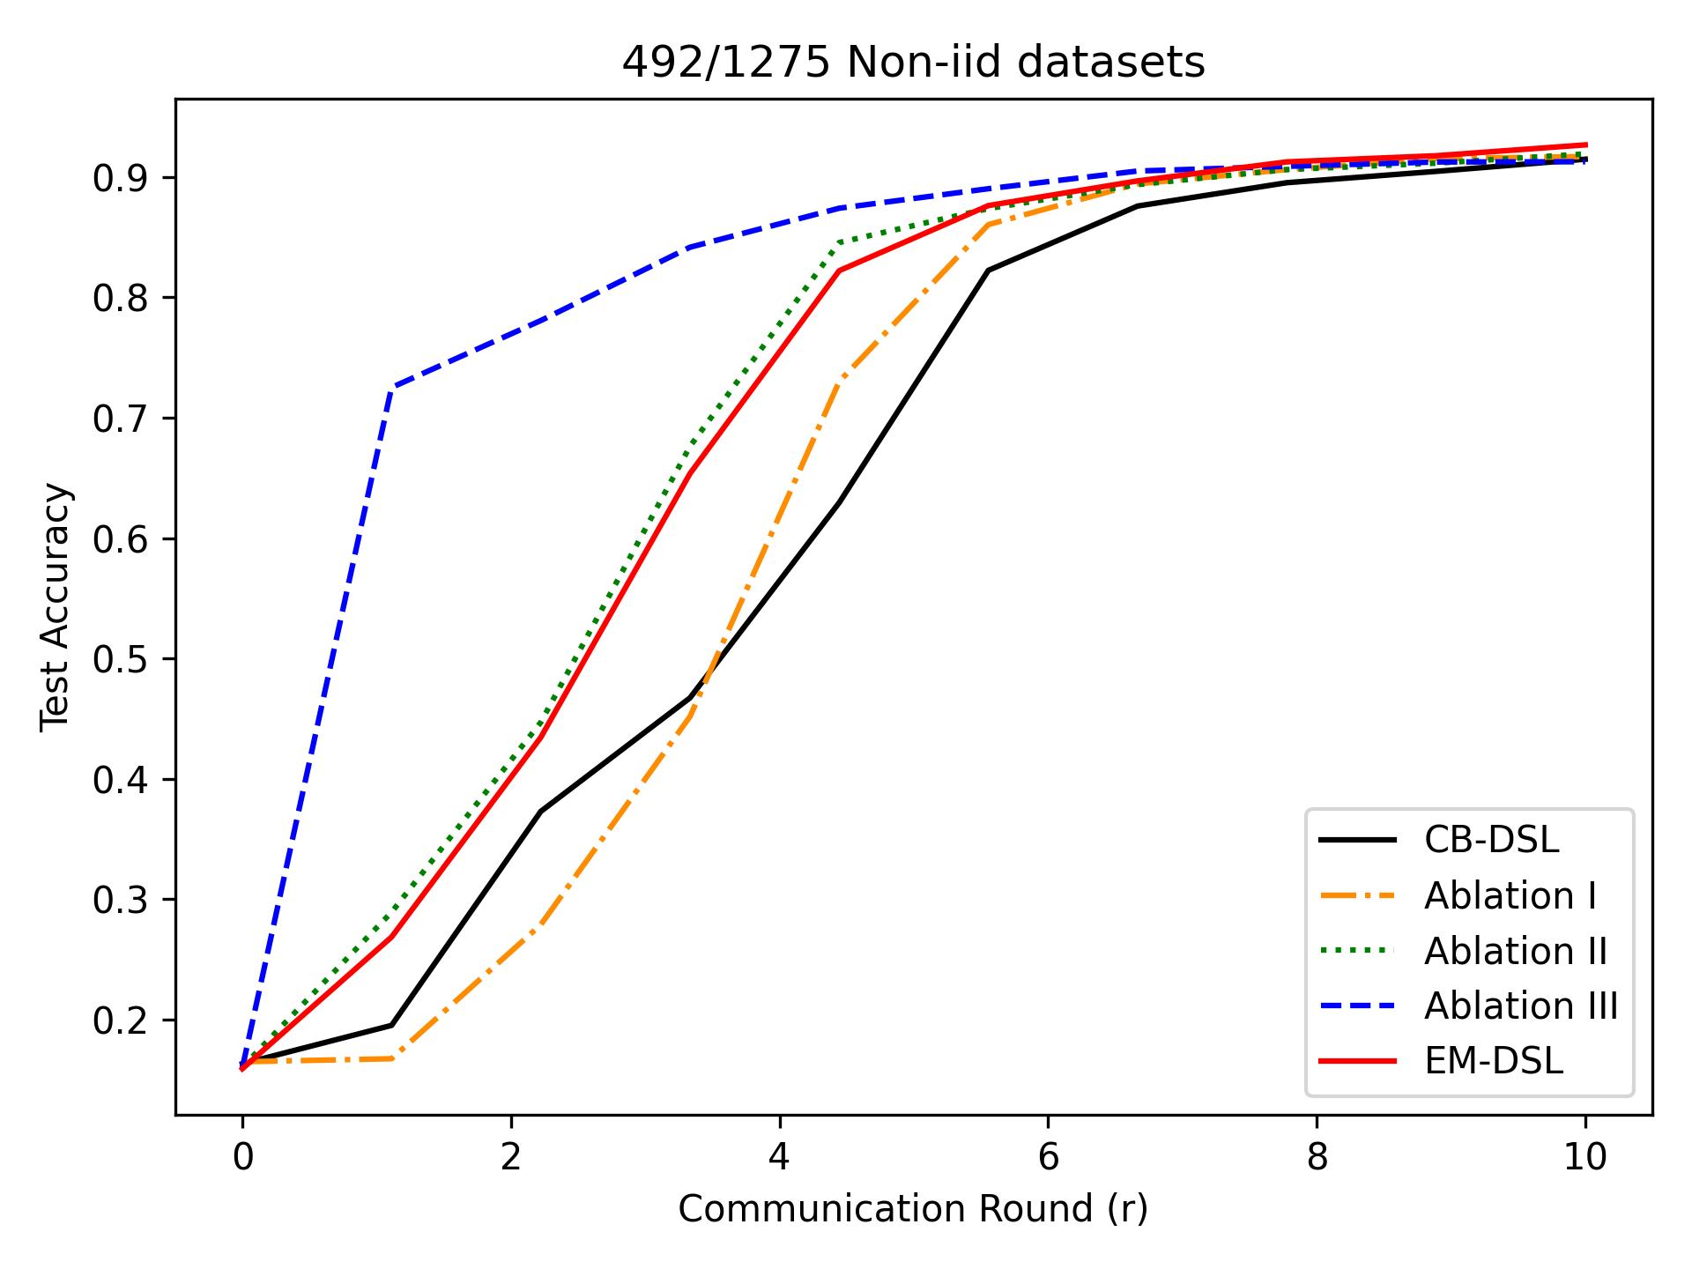
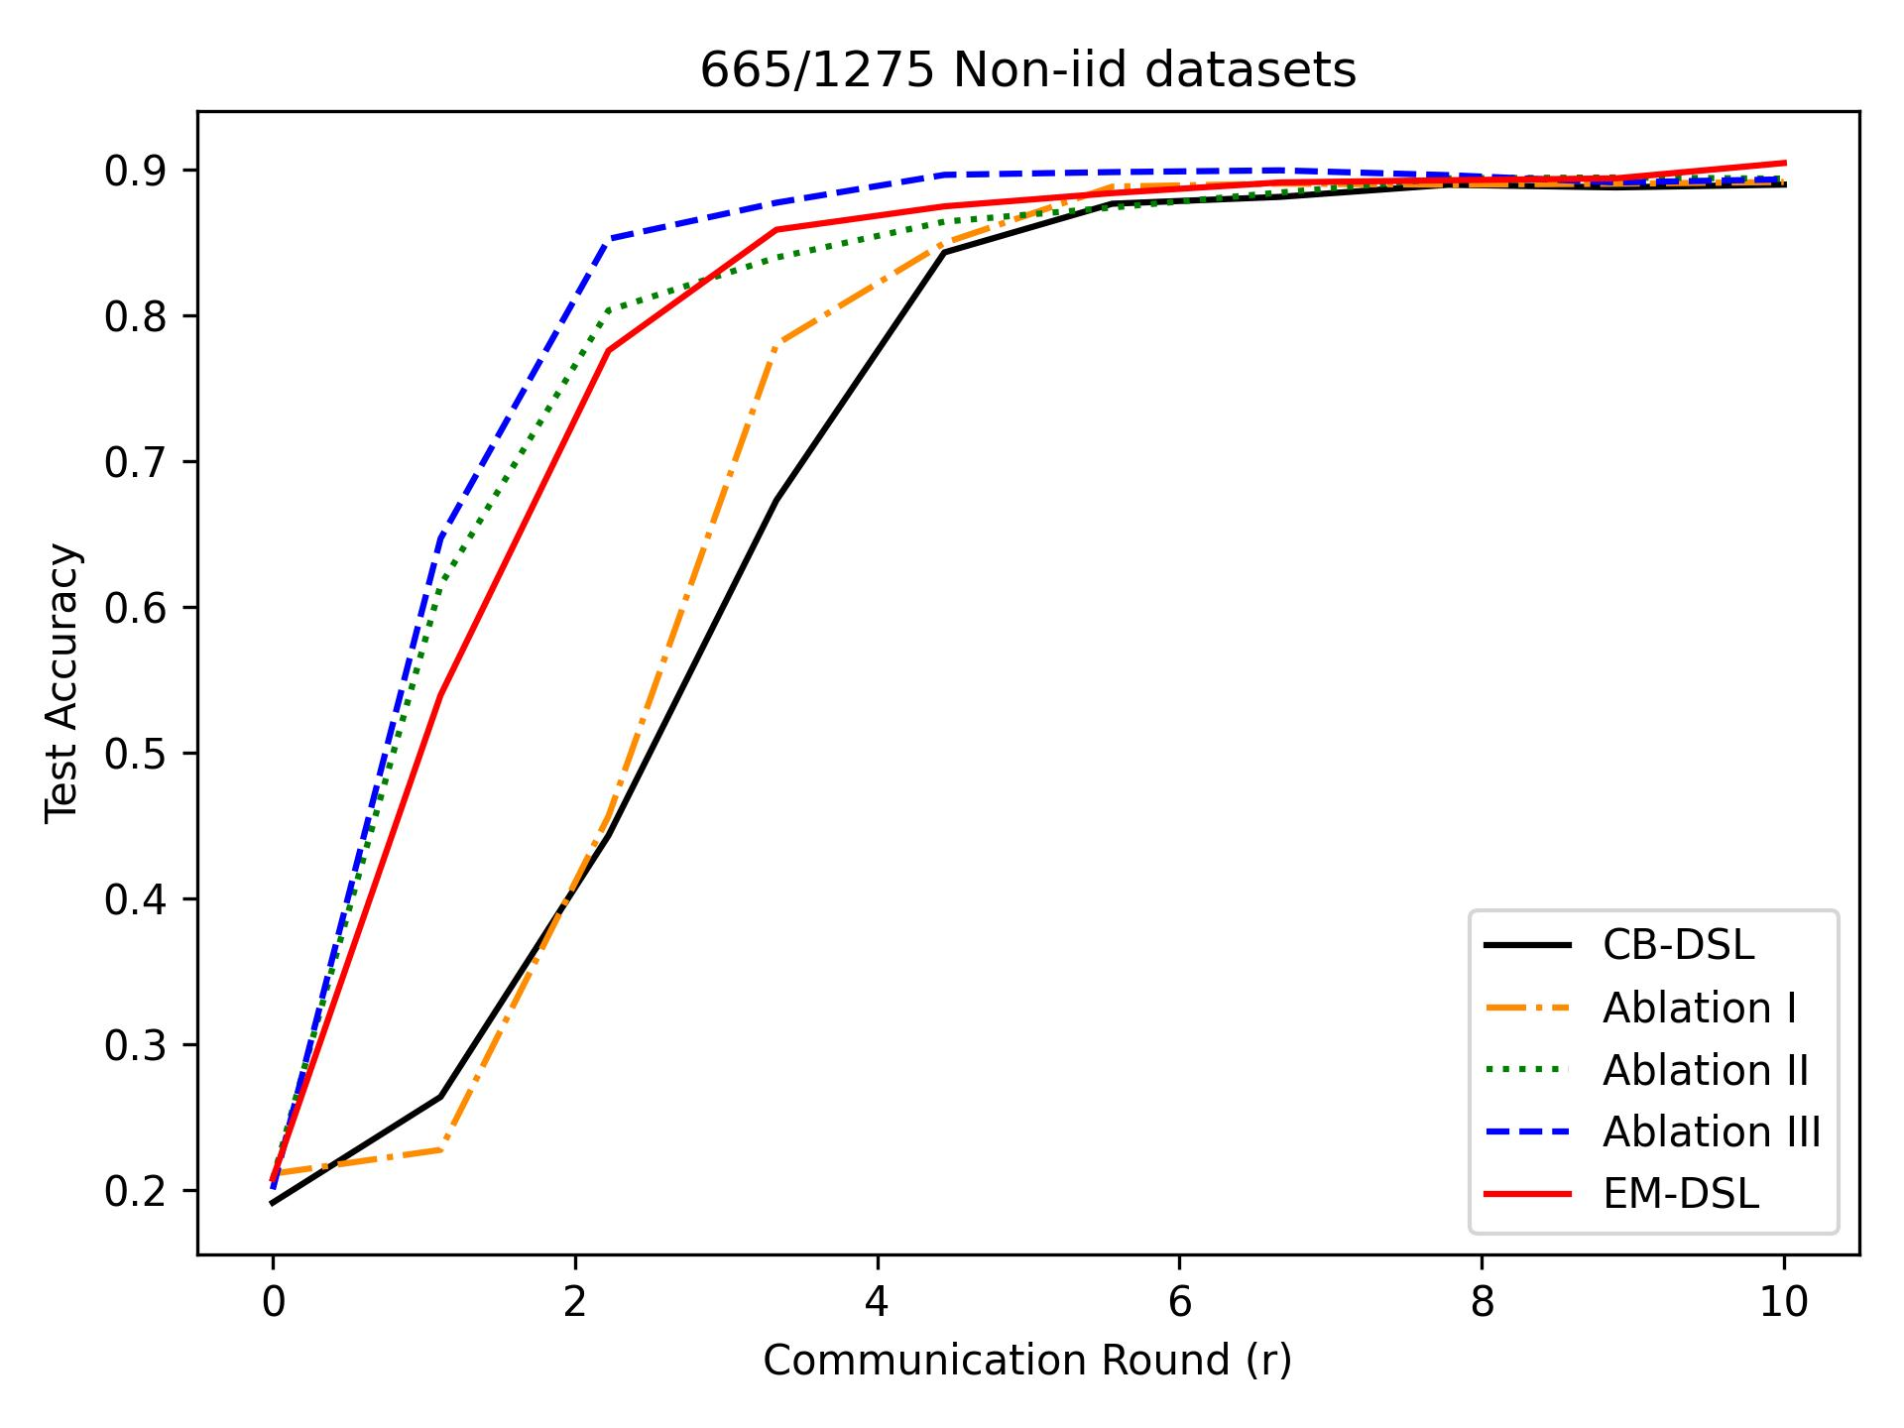
Simulation Result
Ablation Study: EM-DSL = Exploration Score + Selection + Entropy + DSL
CB-DSL= Test Accuracy + Topk + DSL
1. EM-DSL vs CB-DSL vs Test Accuracy + Selection + Entropy + DSL
2. EM-DSL vs CB-DSL vs Exploration Score + Topk + Entropy + DSL
3. EM-DSL vs CB-DSL vs Exploration Score + Selection + DSL

Slide 22
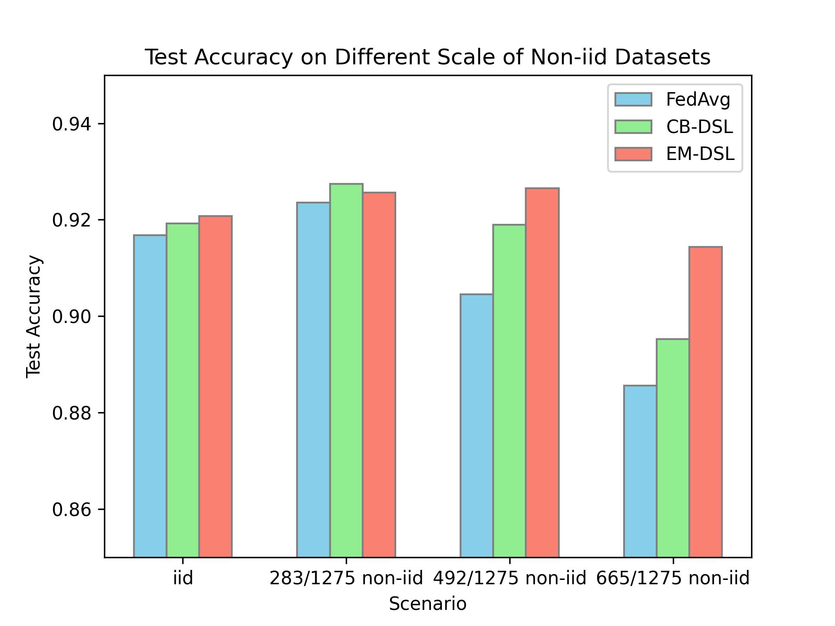
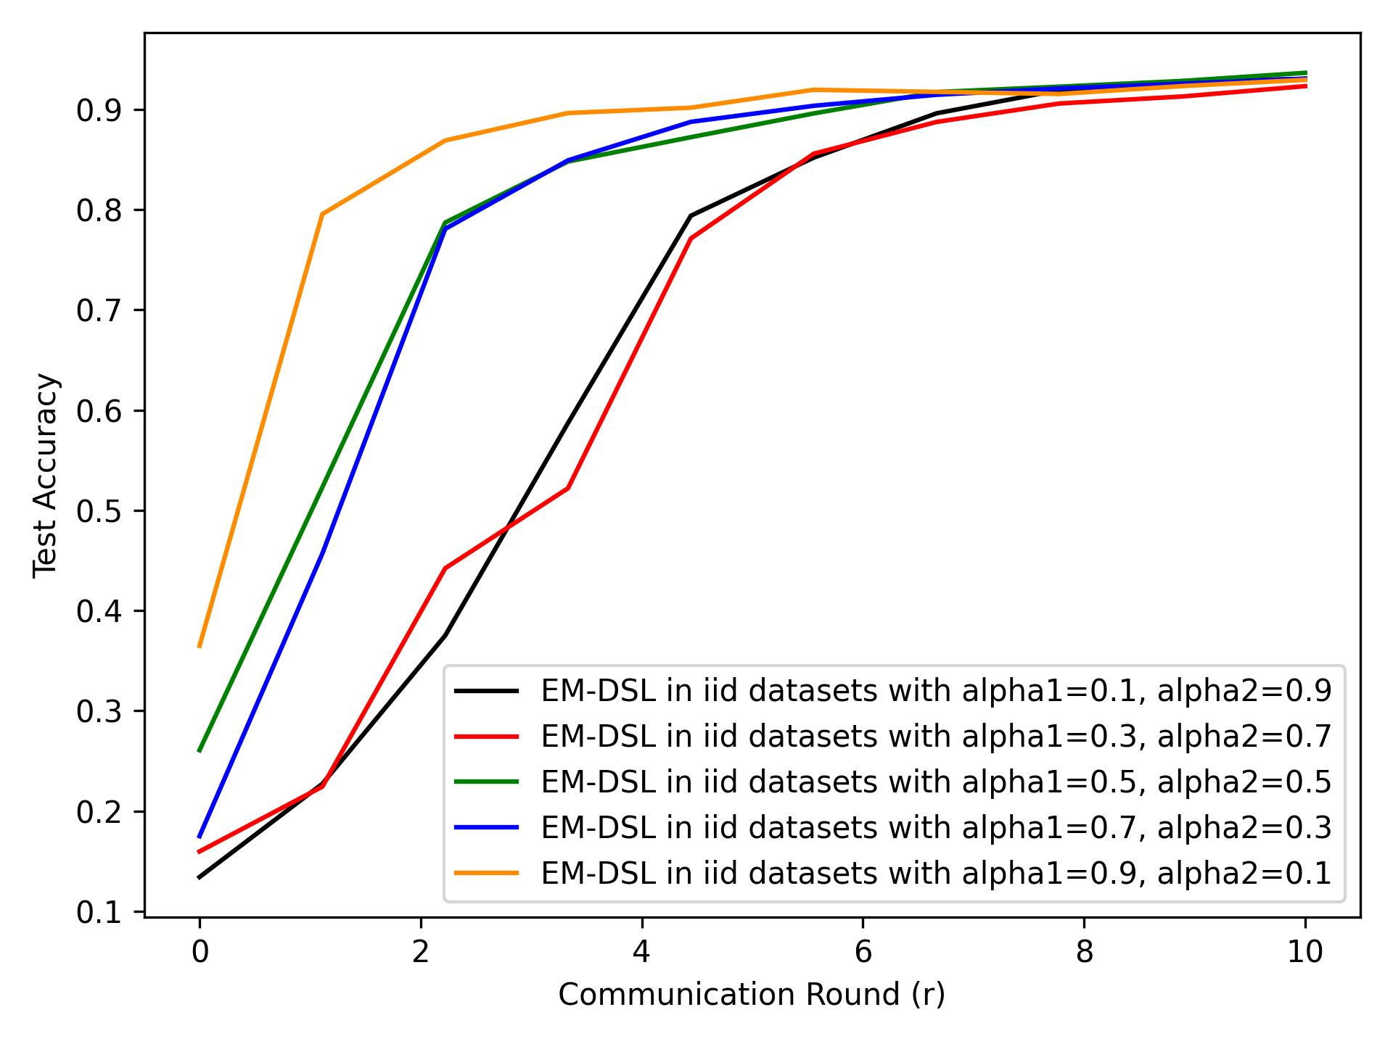
Simulation Result
Comparative Study:
Accuracy in different non-iid datasets.
Improvement vs Diversity:
Results with seed 2355589748

Slide 23
Outline
Introduction
Existing research
Proposed design and method
Preliminary results
Summary and future work

Slide 24
Summary
Multi-worker Selection
Exploration Evaluation
Identify the capacity of local worker
Existing issues
Time-consuming algorithm in EM
Diverse scale no-iid datasets
Experiment with centralized model
Entropy Maximization
To enhance the exploration capacity
Adaptive Weight
Identify the capacity of local worker

Slide 25
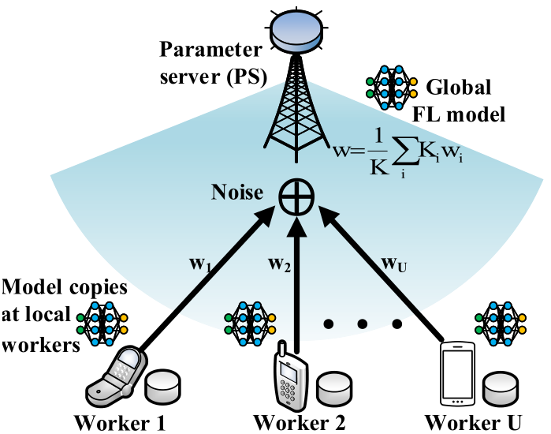

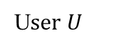
Future Work – DSL OTA
Parameters Aggregation: Over-the-air^{[1]}
User 1
User 2
…
Multiple Access Channel
U$ser U$
Increase U-time commun. Efficiency
Unreachable local params for server
Expensively rely on orthogonal link resources
Sum comes naturally via analog aggregation
[1] Fan X, Wang Y, Huo Y, et al. Joint optimization of communications and federated learning over the air[J]. IEEE Trans. Wireless Commun., vol. 21, no. 6, pp. 4434-4449, 2021.

Slide 26
Future Work – Trustworthy DSL
Parameters Aggregation: Over-the-air^{[1]}
Attacker
User 1
User 2
…
Multiple Access Channel
U$ser U$
Strong privacy, weak security
Solutions: worker identification; differential privacy.

Slide 27

Future Work – Online DSL
Online DSL: Time-varying $𝓓$ and $φ$
Fundamental assumption: Ideal wireless communication
Channel coding ^{[1]} : VAE, RL, Transfer Learning……
[1] Matsumine T, Ochiai H. Recent Advances in Deep Learning for Channel Coding: A Survey[J]. IEEE Open J Commun. Soc, 2024.

Slide 28
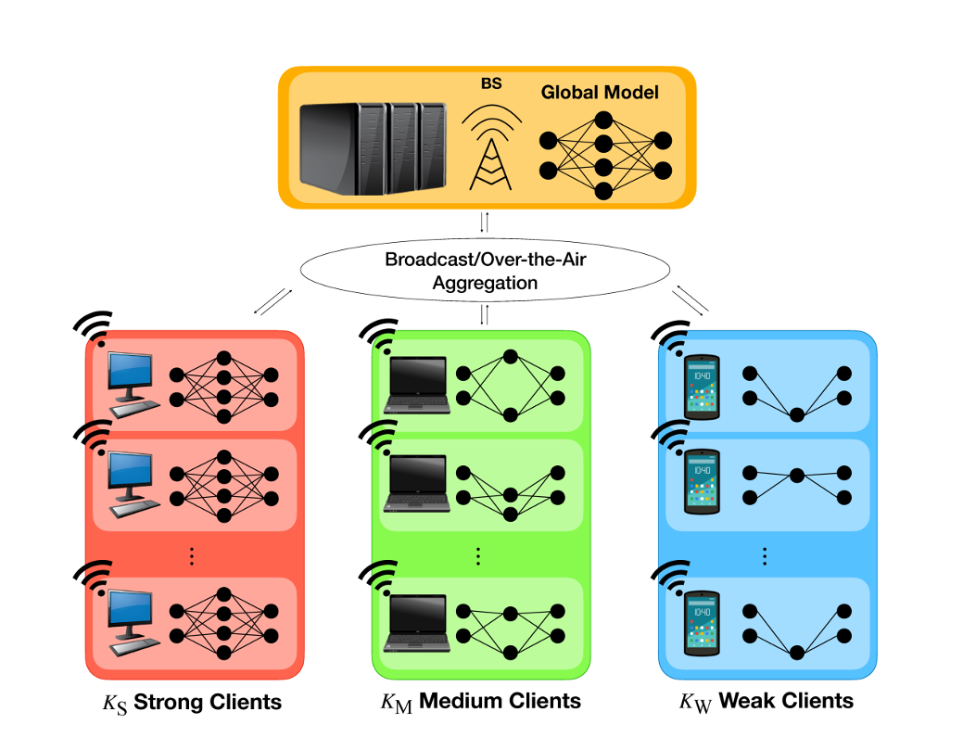
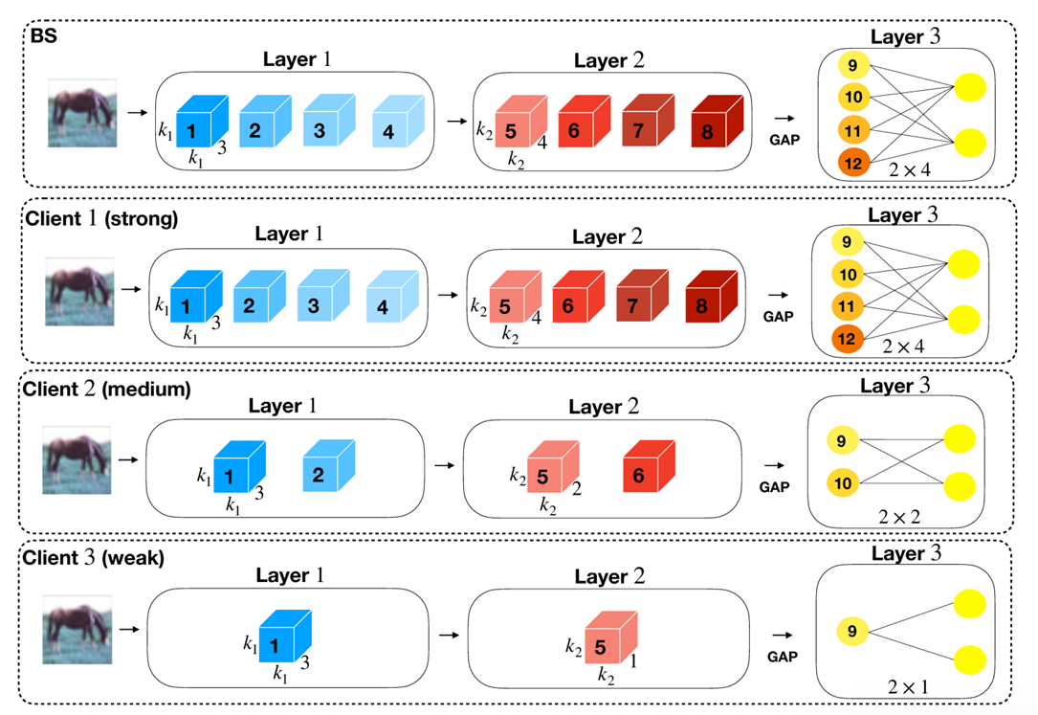
Future Work – DSL with Model Heterogeneity
Online DSL: Model Heterogeneity
Weak workers just take part of training.
Heterogeneity: depth and width.

Slide 29
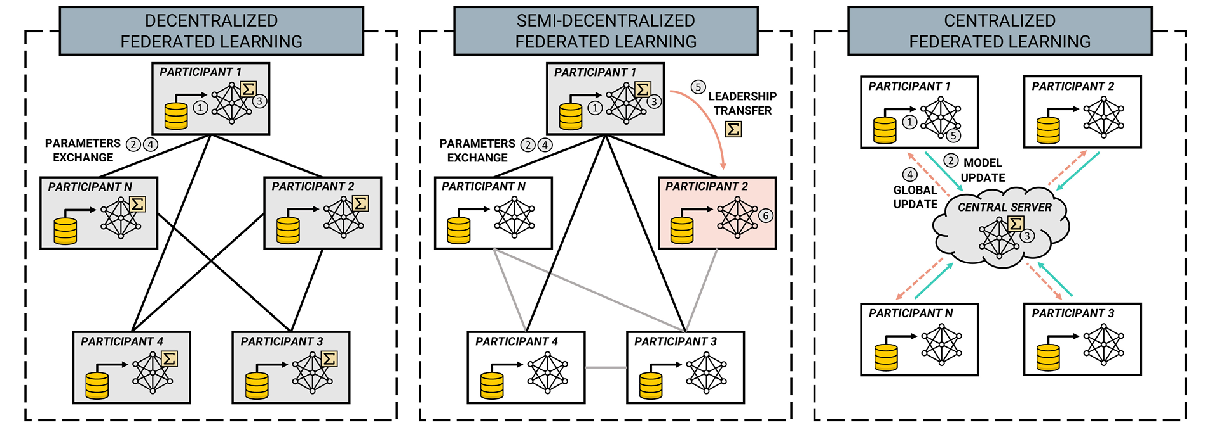
Future Work – DSL in Decentralized Mode
Decentralized DSL ^{[1]}
Robustness, trustworthy, efficiency commun.
Affiliation of better workers: Graph Theory
[1] Beltrán E T M, Pérez M Q, Sánchez P M S, et al. Decentralized federated learning: Fundamentals, state of the art, frameworks, trends, and challenges[J]. IEEE Communications Surveys & Tutorials, 2023.

Slide 30
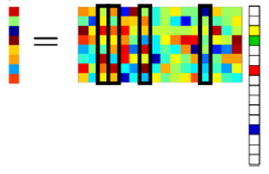
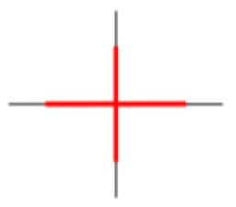

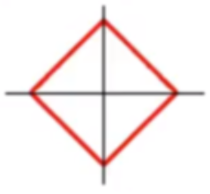
Future Work – DSL with Compressed Sensing
Sampling + Compression ^{[1], [2]} + Recovery
Noise-free case
(P0)
Noisy case
(P2)
(P1)
Sparsity: gradient vectors become sparse as iteration increases
Quantization: hardware limitation leads to noncontinuous values
[1] Y. Wang, Z. Tian, and C. Feng, “Sparsity order estimation and its application in compressive spectrum sensing for cognitive radios,” IEEE Trans. Wireless Commun., vol. 11, no. 6, pp. 2116–2125, 2012.
[2] X. Fan, Y. Wang, Y. Huo, and Z. Tian, “1-Bit Compressive Sensing for Efficient Federated Learning Over the Air,” IEEE Trans. Wireless Commun., vol. 22, no. 3, 2023.

Slide 31
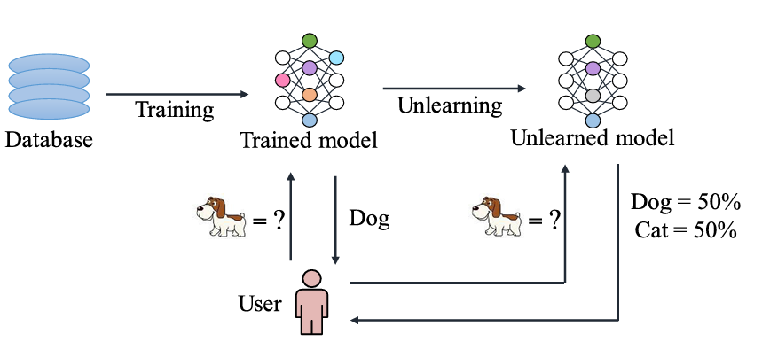
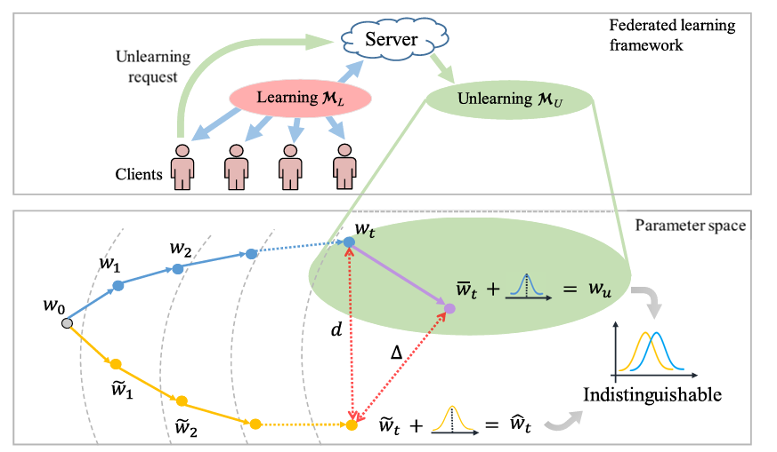
Future work – DSL with Machine Unlearning
Machine Unlearning ^{[1] ,[2]} &DSL:
Real-word application: Privacy demand, Time-varying clients swarm.
Challenge: Resource limitation; Dynamic system; attacker
[1] Gu H, Zhu G, Zhang J, et al. Unlearning during Learning: An Efficient Federated Machine Unlearning Method[J]. arXiv preprint arXiv:2405.15474, 2024.
[2] Zhang L, Zhu T, Zhang H, et al. Fedrecovery: Differentially private machine unlearning for federated learning frameworks[J]. IEEE Trans. Inf. Forensic Secur., 2023.

Slide 32
Thank You!

